Slide 1
Refreshers

Slide 2
Primitive Data Types
Like atoms in chemistry – cannot be broken down, fundamental
byte int
short float
long bool
double char

Slide 3
Reference Data Types
Like molecules in chemistry, made up of others:
enum
array
class
interface
String

Slide 4
Big Differences!
Primitive (int, bool, char, float)
Reference (class, array, enum, String)
Pre-defined and built in
Start with a lower case
Vary in size
Never null
Pass by value – copies
You define them (except String)
Start with upper case
Data inside varies in size
Can be null
Pass by reference

Slide 5
Pass by value/reference
When we call a function with a primitive, we make a copy. They are small and copying them is cheap and easy.
{
int x=1;
addOne(x);
system.out.writeln(x);
}
void addOne(int x){
x=x+1;
}

Slide 6
Pass by value/reference
When we call a function with a reference types, Java tells the method the location of “ours”. This makes it “changeable”.
{
Student x=new Student();
fixGPA(x);
system.out.writeln(x);
}
void fixGPA(Student x){
x.GPA=4.0;
}

Slide 7
Pass by Value/Reference is confusing!
Simple types, always copy, never change.
Complex types, always changeable, never copy.
Why is it this way?
Making copies of complex types is expensive.
Changing contents of simple types “feels weird”.

Slide 8
Basic Math
Add: + +=
Subtract: - -=
Multiply: * *=
Divide: / /=
Modulo: % %=
Order of operations: Please Excuse My Dear Aunt Sally
PEMDAS
Parenthesis, Exponents, Multiply and Divide, Add and Subtract

Slide 9
Ternary Operator ?:
x = y < 4 ? 3 : 2;
Equivalent to:
if (y<4)
x=3;
else
x = 2;
Why does this exist?
Shorter, maybe easier to read. For readability, don’t nest it:
x = y < 4 ? z < 2 ? 4 : 6 : 7;

Slide 10
Loops
while (x<5) {
}
do {
} while (x < 5)
for (int x=0;x<10;x++) { }
for (string x : stringArray) {
}

Slide 11
Conditionals
if (x<5) { } else if (y<5) {
} else {
}
switch (x) {
case 4: // do stuff
break;
case 3: // do other stuff;
break;
default: // do something
break;
}

Slide 12
Nesting
Statements like loops and conditionals that have a block {} can have similar statements inside.
if (x<5) {
if (y < 4) {
}
}
Nesting is just the “vocabulary word” we use for this.

Slide 13
Scope
When you declare a variable it has a lifetime – that lifetime is called scope. The scope of a variable is the set of curly braces where it is defined.
if (x < 5) {
int j = 0;
}
// j doesn’t exist here!
Why? The smaller the scope, the fewer the bugs. Plus, this lets us safely reuse “j” later.

Slide 14
Java With an IDE
I use JetBrain’s IntelliJ. You probably use Eclipse. It doesn’t matter – the tools do the same things.
There are certain things that the IDE (Integrated Development Environment) does for you that we should talk a bit about.
One thing – the IDE may make suggestions to “help” you. Don’t blindly follow them. They are like “auto-correct” on your phone – trying to help and often right but sometimes not.

Slide 15
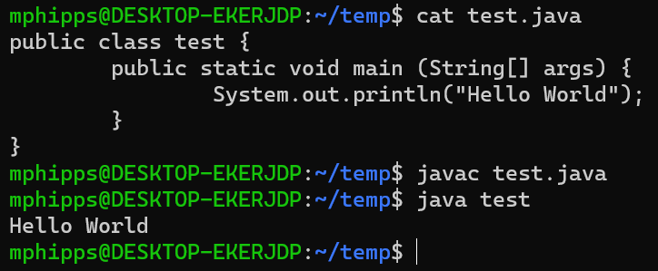
Java Without an IDE
cat prints out a file
javac compiles the class
java runs the class

Slide 16
How some pieces relate
JDK – Java Development Kit – includes “javac” and “java” and all of the programs and parts you need to build and run Java programs.
JRE – Java Runtime Environment – includes “java” and all of the parts that you need to run Java programs (smaller than JDK)
JVM – Java Virtual Machine – part of the JRE – the compiler writes instructions that the JVM can run. JVM is system specific – there is a Mac version, a Windows version, a Linux version, etc.

Slide 17
enum
Enumerables (enum) are the simplest reference types.
They are also incredibly useful for cases where a variable has a fixed number of possibilities and you want to spell them out (enumerate them).
Example:
enum AlertLevel { GREEN, YELLOW, RED }
AlertLevel currentAlertLevel = AlertLevel.RED;

Slide 18
Uses for Enum
Days of the week, days in a month
A small number of colors, suits of cards, units (inches/cm)
States (alert levels, waiting vs running vs paused)
MAYBE types of things (if behavior/contents don’t change)

Slide 19
enum example
public class Card {
public enum Suit { clubs, spades, hearts, diamonds};
public enum Rank { ace, two, three, four, five, six, seven, eight, nine, ten, jack, queen, king}
private Rank rank;
private Suit suit;
public Card (Suit s, Rank rank) {
suit = s; this.rank = rank;
}
public String toString() {
return rank.toString() + " of " + suit.toString();
}

Slide 20
enum example
public static Card[] newDeck () {
Card[] retVal = new Card[52];
int cardNumber = 0;
for (Rank r : Rank.values()) {
for (Suit s : Suit.values()) {
retVal[cardNumber++]= new Card(s,r);
}
}
return retVal;
}
public static void main(String[] args){
for (Card c : Card.newDeck() )
System.out.println(c.toString());
}

